Slide 1
BRIGHT TV
Viewership Analytics
& Growth Recommendations
Insights and strategies to boost audience engagement, optimise scheduling and grow subscriptions.
LESEGO PUTSOA V.1 • FOR THE CEO & STAKEHOLDERS

Slide 2
GLOSSARY
Key terms and abbreviations
A quick reference for the acronyms, data fields and concepts used throughout this deck.
CVM
Customer Value Management — strategy of growing the long-term value of existing viewers through retention, engagement and personalisation.
BrightTV
The streaming platform whose viewership data is being analysed in this report.
SAST
South African Standard Time (UTC+2). All timestamps in this analysis are converted from UTC to SAST.
UTC
Coordinated Universal Time — the global time standard in which the raw RecordDate2 values are stored.
SQL
Structured Query Language — used to query the viewership_tv and user_profiles_tv tables.
JOIN
SQL operation linking viewing sessions to user profiles via UserID, enabling demographic analysis.
RLS
Row-Level Security — database policies that restrict which rows a user may read or write.
KPI
Key Performance Indicator — a measurable value that tracks progress against business goals.
HH:MM:SS
Hours:Minutes:Seconds — the format of the Duration 2 field, converted to seconds for aggregation.
Age Groups
Children (<18), Youth (18–35), Adults (36–59), Pensioners (60+) — derived from the Age field.
Time of Day
Morning (05–11), Afternoon (12–16), Evening (17–20), Night (21–04) — bucketed from SAST hour.
Churn
When a subscriber stops watching or cancels their subscription — the key risk CVM aims to reduce.
BRIGHTTV • VIEWERSHIP ANALYTICS
2 / 9

Slide 3
THE OBJECTIVE
Turning viewership data into subscription growth
Strategic Goal
Data Foundation
CVM Lens
Outcome
Grow BrightTV subscriptions in a competitive streaming market by deepening engagement and retention.
Session-level viewership joined with user profiles — UTC times converted to SAST (UTC+2).
Analytics inform targeted initiatives that increase customer lifetime value and reduce churn.
Scheduling, personalisation and off-peak engagement plays tailored to real audience behaviour.
BRIGHTTV • VIEWERSHIP ANALYTICS
2 / 8

Slide 4
DATA FOUNDATION
Two datasets, one viewer story
viewership_tv
user_profiles_tv
Viewing Sessions
Subscriber Profiles
Each row is a single viewing session — user, channel, start time and duration. Powers all behavioural metrics: who watched, what, when and for how long.
Demographic context joined to every session — gender, age, province and race. Turns raw viewing into segmented insight.
1
row = 1 session
LEFT JOIN
on UserID
UTC→SAST
+2 hours applied
4 dims
age • gender • province • race
BRIGHTTV • VIEWERSHIP ANALYTICS
3 / 8

Slide 5
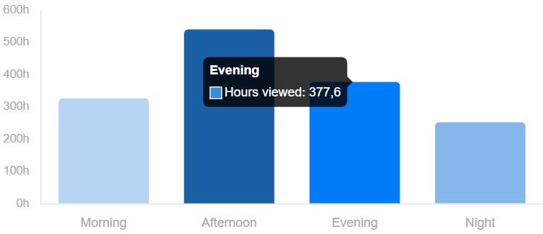
WHEN VIEWERS WATCH
Afternoons spike, evenings hold strong
Key Takeaways
Afternoon leads
Highest hours of any window — the platform's daily peak.
Evening close second
377.6 hrs viewed — prime slot for premium and live content.
Mornings warm up
Steady ~320 hrs — great for catch-up and short-form.
Nights are quietest
Lowest engagement — opportunity for replays and background play.
Hours viewed by time of day (SAST)
BRIGHTTV • VIEWERSHIP ANALYTICS
4 / 8

Slide 6
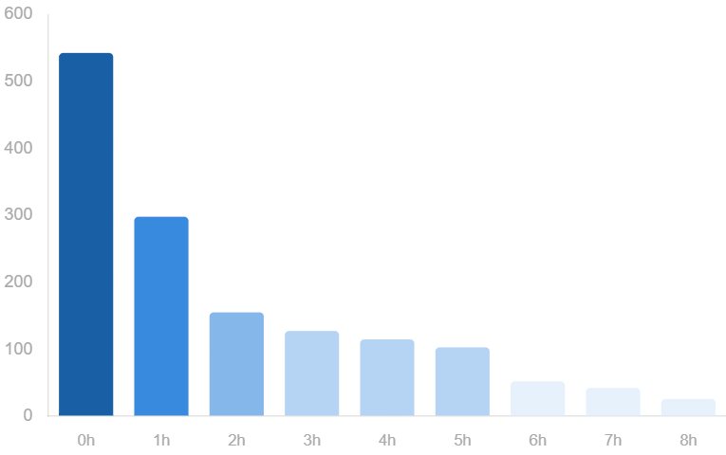
HOW LONG VIEWERS WATCH
Most sessions are short — engagement tails off fast
Short, frequent sessions
540+ sessions under 1 hour
Viewers dip in and out — modern, on-the-go consumption.
~300 sessions in the 1–2 hr range
A second healthy cluster of meaningful engagement.
Long-form is rare
Beyond 5 hours sessions drop sharply — few binge viewers.
Action
Optimise highlights, recaps and short-form to match real habits.
Distribution of viewing-session lengths (hours)
BRIGHTTV • VIEWERSHIP ANALYTICS
5 / 8

Slide 7
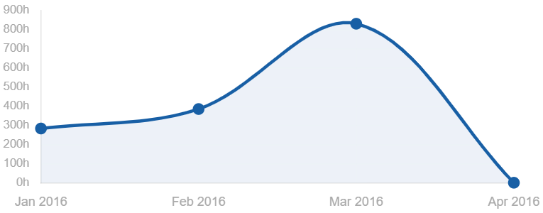
MONTH-OVER-MONTH MOMENTUM
Viewership built into March — then dropped sharply
What it means
March is the breakout month — likely event-driven (live sport, premieres).
The sharp April fall is an early-warning churn signal worth investigating.
Plan in rolling cycles, not isolated monthly bursts.
Total hours viewed by month (SAST)
Trigger interventions — push notifications, featured collections — when monthly hours dip.
275h
375h
830h
0h
Jan 2016
Feb 2016
Mar 2016 — peak
Apr 2016 — drop-off
BRIGHTTV • VIEWERSHIP ANALYTICS
6 / 8

Slide 8
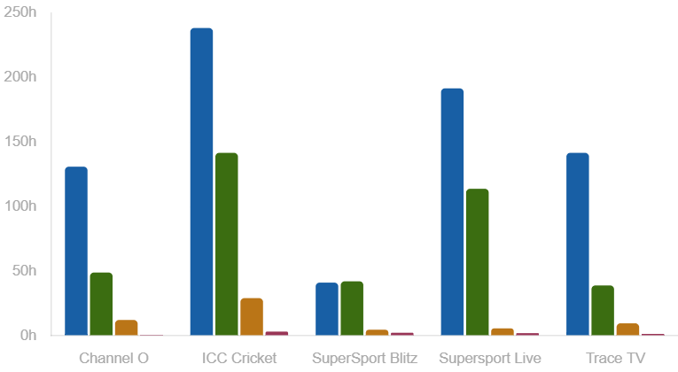
WHO WATCHES WHAT
Sport channels dominate — and the youth lead the way
Audience signals
ICC Cricket leads
Highest hours overall — a clear flagship engagement driver.
SuperSport Live close behind
Live sport keeps subscribers watching longest.
Youth (18–35) dominate
Largest viewing share across every channel — prioritise them.
Children & pensioners are light
Underserved segments — opportunity for tailored line-ups.
Hours viewed by channel × age group (youth • adults • pensioners • children)
BRIGHTTV • VIEWERSHIP ANALYTICS
7 / 8

Slide 9
RECOMMENDATIONS
Five plays to grow subscriptions
1
Move from monthly bursts to rolling momentum
2
Use top channels as platform traffic drivers
Plan in cycles. Use mid-cycle refreshes so March-style peaks aren't followed by April-style drops.
Cross-promote lighter channels off ICC Cricket and SuperSport with "if you enjoyed this, try…" placements.
3
Programme to time-of-day behaviour
4
Personalise by age and province
Short, repeatable content for mornings & nights. Premium and live for the afternoon–evening peak.
Lead with youth-focused, sport-rich line-ups; build tailored bundles for under-served pensioners and children.
5
Make performance tracking actionable
Dashboards that flag declining channels, months and time slots automatically — not just report what happened.
Aligned to the CEO's growth objective — engage harder, retain longer, convert more.
BRIGHTTV • VIEWERSHIP ANALYTICS
8 / 8

